Slide 1
Mobile Application Development - Day 9
Snackbar
Activity Life Cycle
Fragment

Slide 2
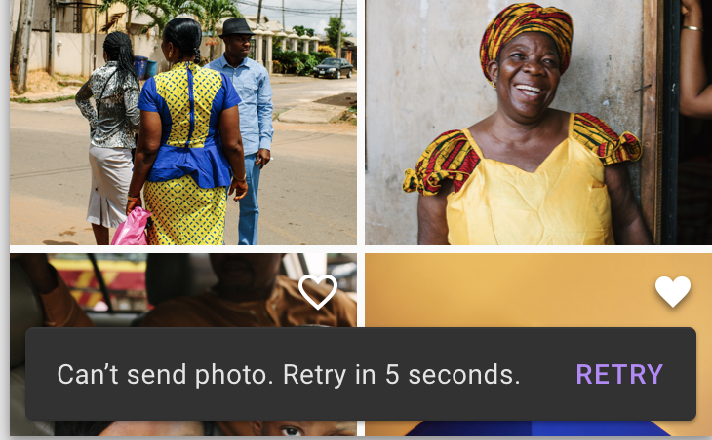
Snackbar
provides brief feedback about an operation through a message at the bottom of the screen
disappear automatically,
either after a timeout or
after a user interaction elsewhere on the screen
can also be swiped off the screen.
offer the ability to perform an action, such as undoing an action that was just taken, or retrying an action that had failed.
Snackbars work best if they are displayed inside of a CoordinatorLayout.

Slide 3
Snackbar Vs Toast
Snackbar may have action button optionally, a Toast message doesn’t have a action button
Snackbar can we swiped off the screen before the time limit but Toast message cannot be off until time limit finishes
Toast message and Snackbar have display length property in common.

Slide 4
Snackbar
Default
Snackbar.make(contextView, R.string.item_removed_message, Snackbar.LENGTH_SHORT).show();
Action
Snackbar.make(view, "Text to display", Snackbar.LENGTH_LONG) .setAction("UNDO", new View.OnClickListener() {
@Override
public void onClick(View view) {
} })
.show();

Slide 5
Activity
Activity represents a single screen of Android app’s user interface
Android activity is very similar to windows in a desktop application.
Each android activity must be registered in AndroidManifest.xml
<manifest ... >
<application ... >
<activity android:name=".ExampleActivity" />
...
</application ... >
...
</manifest >

Slide 6
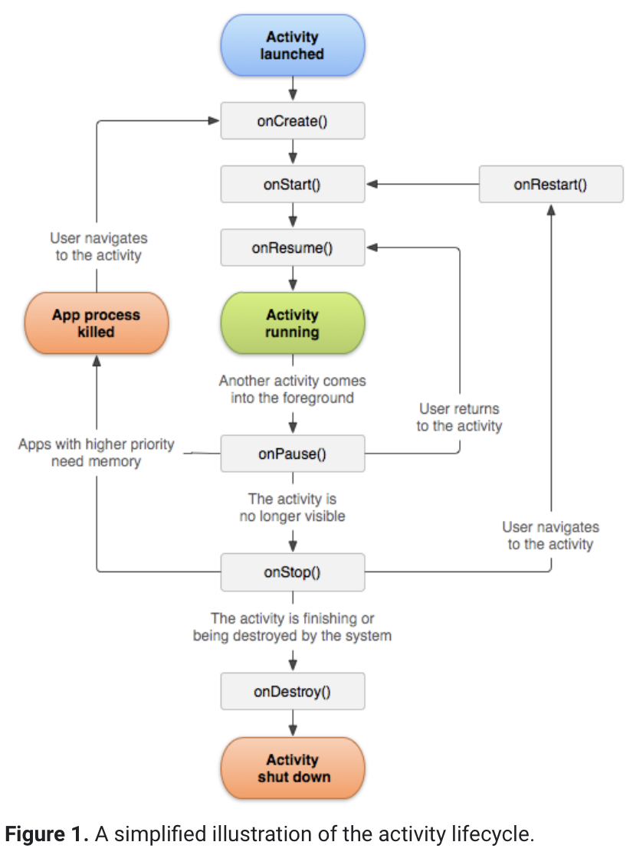
Activity Life Cycle

Slide 7
Activity Life Cycle
onCreate()
onStart()
onResume()
onRestart()
onStop()
onDestroy()

Slide 8
Activity Life Cycle - onCreate()
This is the first call back method
It fires when the system creates an activity for the first time.
If we have application startup logic that needs to perform only once during the life cycle, we can write that login in onCreate() method.
E.g. create views and bind data to lists here
call setContentView() to define the layout for the activity's user interface.

Slide 9
Activity Life Cycle - onStart()
This method is invoked right after the completion of onCreate method
This method makes activity visible to user and execution will be very quick.

Slide 10
Activity Life Cycle - onResume()
Users can start interacting with the app
The app will stays in this Resumed state until an another activity happens to take focus away from the app like getting a phone call or screen turned off, etc.
In case if any interruption events happen in Resumed state, the activity will entered into Paused state and the system will invoke onPause() method.

Slide 11
Activity Life Cycle - onPause()
Whenever the user leaves an activity or the current activity is being Paused then the system invoke onPause() method.
The onPause() method is used to pause an operations like stop playing the music when the activity is in paused state or pass an activity while switching from one app to another app because every time only one app can be focused.

Slide 12
Activity Life Cycle - onStop()
The onStop() method is useful to release all the app resources which are no longer needed to the user.
The system will invoke onStop() callback method when an activity no longer visible to the user

Slide 13
Activity Life Cycle - onRestart()
The system will invoke onRestart() method when an activity restarting itself after stopping it.
The onRestart() method will restore the state of activity from the time that is being stopped.
The onRestart() callback method in android activity will always followed by onStart() method.

Slide 14
Activity Life Cycle - onDestroy()
The system will invoke onDestroy() method before an activity is destroyed and this is the final callback method which received by the android activity.
The system will invoke this onDestory() callback method either the activity is finishing or system destroying the activity to save space.

Slide 15
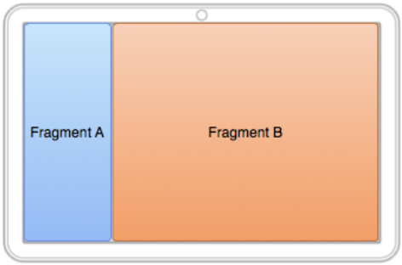
Fragment
represents a portion of user interface in a activity.
must be always hosted in an activity.
can combine multiple fragments in a single activity.
Fragment’s life cycle is directly affected by the host activity’s.
E.g.
When activity is paused, so are all fragments
When activity is destroyed, so are all fragments
Can manipulate each fragment independently such as add or remove then. (can be called as fragment transaction)
Fragments can be added in back stack that’s managed by activity -each back stack entry in the activity is a record of fragment transaction that occurred.
Back stack allows the user to reverse a fragment transaction by pressing the Back button.

Slide 16
Fragment - Create Fragment
XML
Programatically

Slide 17
Create Fragment - XML
<LinearLayout xmlns:android="http://schemas.android.com/apk/res/android"
android:orientation="horizontal"
android:layout_width="match_parent"
android:layout_height="match_parent">
<fragment android:name="com.example.news.ArticleListFragment"
android:id="@+id/list"
android:layout_width="0dp"
android:layout_height="match_parent" />
<fragment android:name="com.example.news.ArticleReaderFragment"
android:id="@+id/viewer"
android:layout_weight="2"
android:layout_width="0dp"
android:layout_height="match_parent" />
</LinearLayout>

Slide 18
Create Fragment - Programatically
FragmentManager fragmentManager = getSupportFragmentManager();
FragmentTransaction fragmentTransaction = fragmentManager.beginTransaction();
ExampleFragment fragment = new ExampleFragment();
fragmentTransaction.add(R.id.fragment_container, fragment);
fragmentTransaction.commit();

Slide 19
Sample Question
Explain Snackbar. Write a program to display Snackbar.
Explain Activity Life Cycle.
What is Fragment? Write a program to display fragment.
Short notes
Snackbar and Toast

